Slide 1
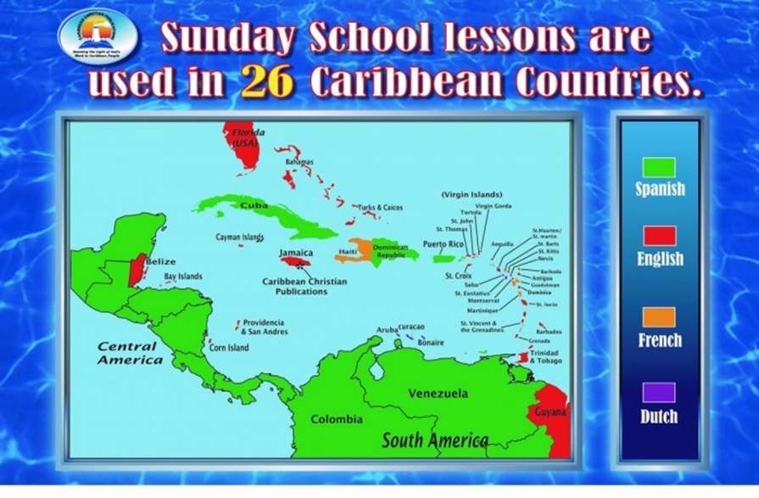
Our Inhabitants & our Morphing Culture
Dutch
Spanish
French
English

Slide 2
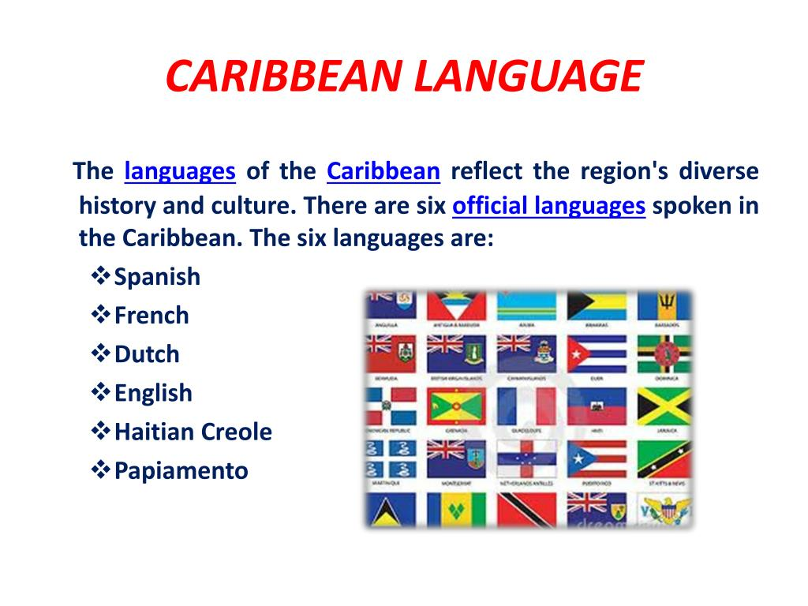

Slide 3
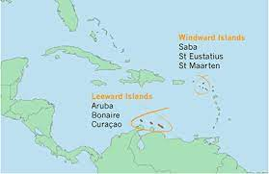
Dutch Caribbean
Multiple Inhabitants – strategic trading and territorial monopoly
Rich source of tradeable goods & commodities
Bonaire, Sint Eustatius, & Saba opted instead to become special municipalities of Netherlands.
Europeans (Columbus in 1492), Spain , France, The Netherlands, Britain
Corn, sugar, cotton, tobacco, indigo, salt, coffee, oil and slaves
Dutch West India Company (WIC) conquered in 17th Century
Used the island as military outposts and trade bases.
1815 officially became a colony of the Netherlands, as the Netherlands Antilles.
Second World War
Process of decolonization began
In 2010, Curacao and Sint Maarteen also became independent.
Aruba gained the status of a separate country in 1986
Formally part of the Netherlands Antilles
Group of islands in the Caribbean comprising of; Aruba, Bonaire, Curacao, Sint Maarten, Saba and Sint Eustatius.

Slide 4
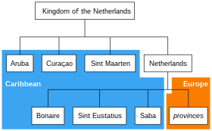
Dutch Caribbean Netherlands Antilles
C’bbean Netherlands
Aruba
Curacao
Sint Maarten
Independent Nation
Suriname

Slide 5
Spanish ‘discovery’ & colonization
Caribbean was used as a ‘bridge’ to go to the mainland
Economy based on factories and later established settlement colonies
Established a monopolist trade regime – mercantilism
Use of native & foreign slave work force
Diffusion of the Catholic religion

Slide 6
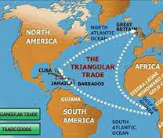
Mercantilism & its impact
Mercantilism refers to a trade economic system (16th – 17th Centuries).
Based on the principle that wealth is static Efforts are to be made to accumulate as much wealth as possible.
Accumulation of the largest possible share of wealth was possible by maximizing exports and limiting imports through use of tariffs.
Promoted a controlled production & trade by adoption of trade restrictions.
Special effort to collect precious metals like gold and silver
Mercantilism faded with the evolution of the Industrial Revolution and capitalism.
Spain maintained the mercantilism, system and so established a closed trade system that forbids trade with third partners and even between the colonies. Trade was only through Spain and controlled by the Spanish Crown

Slide 7
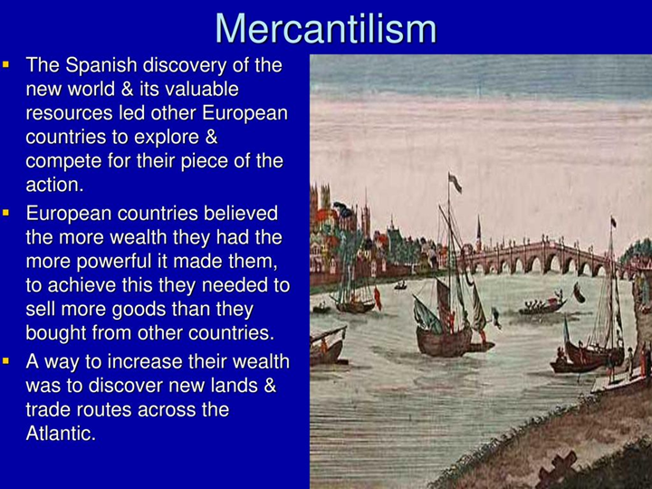
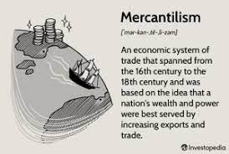
Mercantilism
Spanish discovery of the new world & its valuable resources led other European countries to explore & compete for their piece of the pie
Europeans believed that more wealth meant more power and so they need to sell more than they bought from other countries
Way to increase wealth was discover new lands & trade routes across the Atlantic.

Slide 8
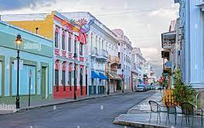
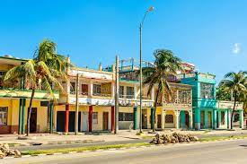
Spanish Influence
Cultural complex with a shared identity
Architecture
Religion
Ethnical composition

Slide 9
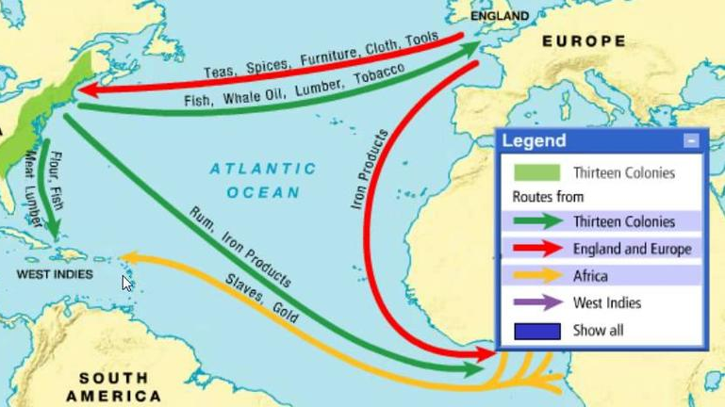
Transatlantic Slave Trade

Slide 10
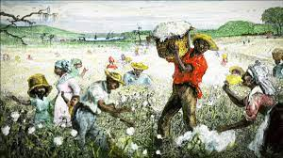
Plantation Economy Model
Economic model based on agricultural mass production, usually of a few commodity crops grown on large farms. Crops were to be export as part of a larger model of overseas economy.
Main crops in the Caribbean included cotton, rubber, sugar cane, tobacco.
Supplies and capital good are imported.
The use of slaves was a cheap way to supply labour force. When capturing, transporting, buying and maintaining slaves in the colonies became expensive, they were substituted by ‘free’ workers.

Slide 11
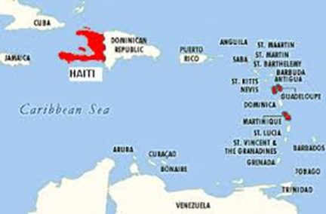
French Caribbean territories currently under French sovereignty in the Caribbean
French Republic
Guadeloupe
Martinique
Saint Martin
French Guiana
Independent Nations
Haiti
Dominica
Saint Lucia

Slide 12

English Caribbean
Anguilla
Suriname
Aruba
Bahamas
Bermuda
British Virgin Islands
Dominica
Jamaica
Montserrat
Saint Lucia
Saint Kitts & Nevis
Turks & Caicos
Antigua & Barbuda
Barbados
Cayman Islands
Grenada
Netherland Antilles
Saint Vincent & the Grenadines
Trinidad & Tobago

Slide 13
English & its Development
English spoken by settlers from the British Isles;
Passed on to descendants & others largely through the normal processes of language transmission: infants learned it from their elders and adults learned it through fairly close daily contact with native speakers;
First generation of settlement in Caribbean - transmitted English predominated only in the early seventeenth century;
Importation of African slaves resulted in restructured English – becoming Creole;
Distinct language system with words derived from English but with phonology, semantics and morphosyntax influenced by African languages.
Became established as first language of entire communities - creolised English was transmitted like any other language.
Over the years, Creole came to influence (and be influenced by) the standard and regional varieties of English brought from Britain;
Uncreolised varieties survived among a few relatively isolated groups made up largely of whites;
Standard English survived as language of administration & education in all the territories that remained British colonies.

Slide 14
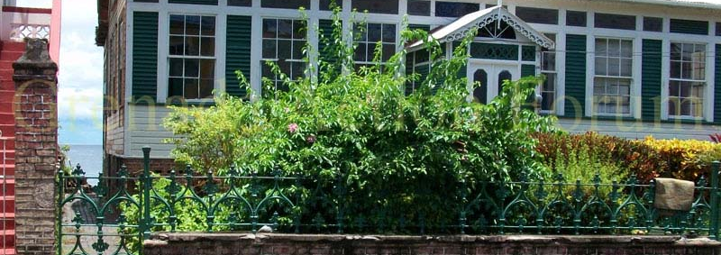
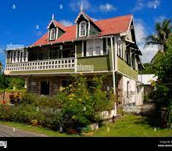
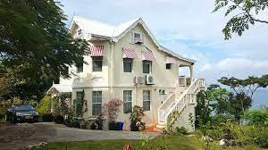
French, Spanish, & English Architecture

